Slide 1

EH EYE
We predict the future. We define the future.
Tham Yong Hao
Low Thien Shawn
Vibin Mathiparambil Vinod

Slide 2
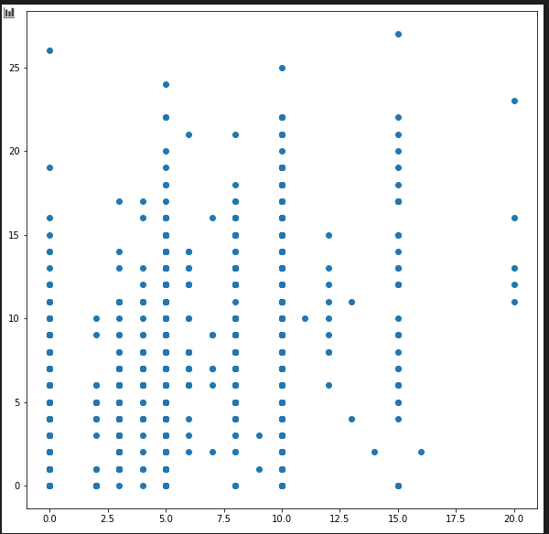
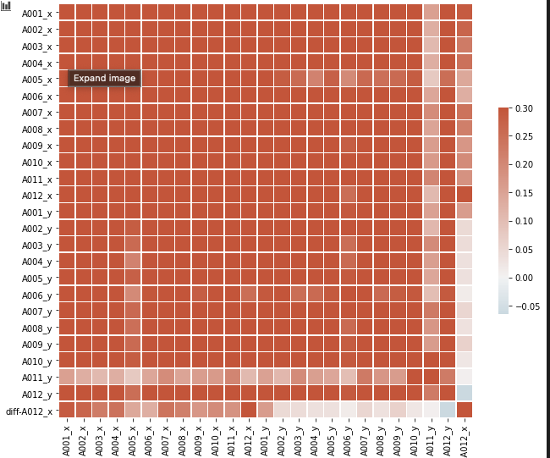
Data Analysis of Sales against Purchases

Slide 3
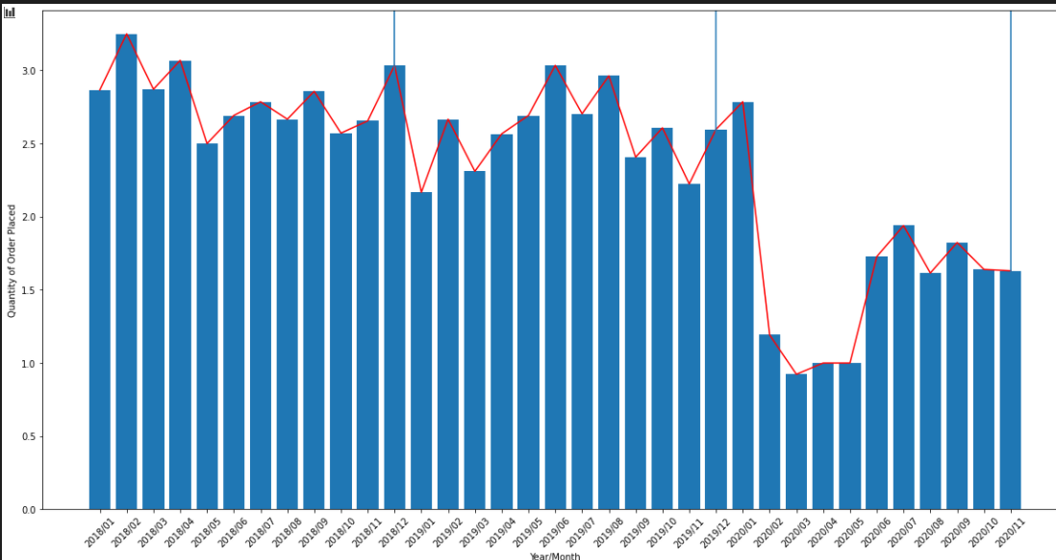
Purchases Trend From Jan 2018 to Dec 2020

Slide 4
Time Series Forecasting with Facebook Prophet
Reindexed the data with a complete set of dates
Extracted features like day of week, quarter, month, year, day of year, day, week of year
Split data to train and test set
Train model and predict
Pad negative values
An open-source library designed for making forecasts for univariate time series datasets
Steps we took:

Slide 5
Using Yearly Trends

Slide 6
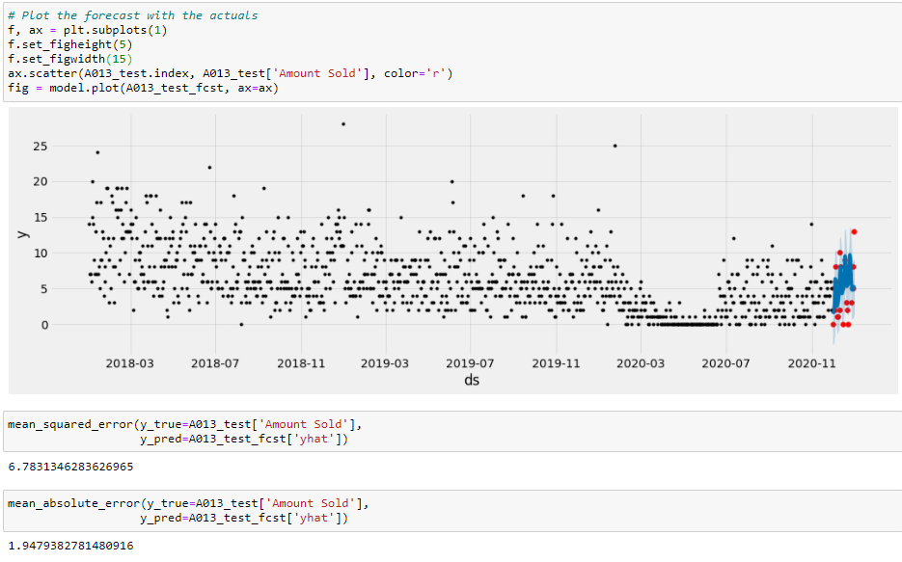
Using Monthly trends

Slide 7
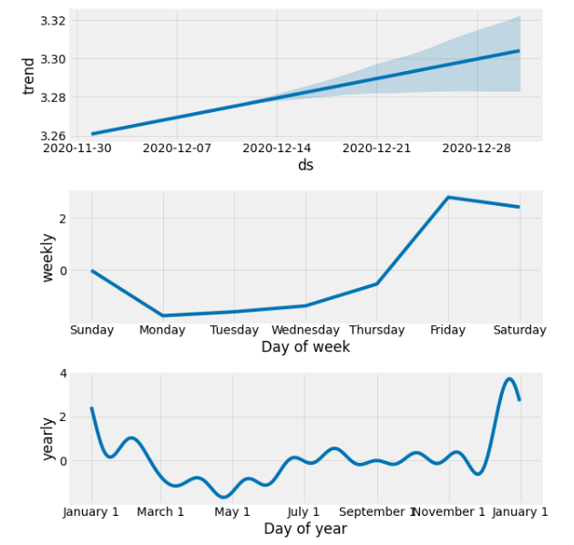
Component graphs

Slide 8
Results
Purchases Predictions
To fit with the chefs daily decisions
Sales Predictions
To fit with the predicted daily sales
Stock up accordingly
Generated a converter to change this data into daily ingredient needs
Minimise wastage

Slide 9
Reasons for differences between actual data and predicted data
The Covid-19 trend has affected the time series analysis to a certain extent, insufficient data to predict the data even more accurately
The purchases is all based on the intuition of the chefs and hence, there might be some anomalies that we were not able to account for given limited time

Slide 10
Other variables needed
Inventory cycle stage
Perishability of ingredients
Weather
Important holidays

Slide 11
Live Demo of User Interface

